Slide 1
Music Genre Classification
Predicting Music Genre with CNN
Banothu Harshini - 210001008
Roopa Sri - 210001044
Kopoori Poojitha - 210001031
Course Instructor
Dr. Aruna Tiwari

Slide 2
Outline
Introduction
Problem Statement
Analysis
Data Preprocessing
Model Architecture
Model Accuracy
Experiment & Results
Conclusion

Slide 3
Introduction
Our primary objective is to engineer a cutting-edge music genre classification system utilising the capabilities of Convolutional Neural Networks (CNNs). In the rapidly evolving landscape of digital music, where vast libraries continue to grow exponentially, the need for an automated genre classification system becomes increasingly vital. Such systems are not only crucial for simplifying content navigation but also play a significant role in enhancing the functionality of recommendation engines and streamlining the management of large-scale music databases.

Slide 4
Problem Statement
The task at hand is music genre classification, where we analyse audio signals and assign them to genres like rock, jazz, or hip-hop. This task is challenging because music perception is complex and subjective, with blurry genre boundaries. However, automated genre classification is essential for tasks like music recommendations and personalised playlists.
Our goal is to build an accurate and efficient music genre classification system using machine learning, specifically Convolutional Neural Networks (CNNs). We'll work with a dataset of audio samples, preprocess the data, extract relevant features, design and train a CNN model, and then evaluate its performance based on metrics like accuracy and F1-score. Ultimately, we want a reliable system that can classify music genres across various datasets and real-world situations.

Slide 5
Analysis
Data Collection: Gather a diverse dataset of audio samples labeled with genres. We used the GTZAN dataset from Kaggle.
Preprocessing: Prepare audio data for the CNN model by ensuring consistent format, segmenting files, and extracting features like MFCCs, Spectral Flux, and Chroma features.
Model Design (CNN Architecture): Design the CNN with layers for feature extraction (Convolutional), downsampling (Pooling), non-linearity (Activation), and classification (Dense).
Model Training: Train the CNN using the prepared dataset to optimize weights and biases for accurate genre classification.
Evaluation: Assess the model's performance on new data to ensure accuracy.
Deployment: Integrate the trained model into applications like music streaming services for automatic genre classification of new audio data

Slide 6
Data Preprocessing
Format Conversion: Firstly, we ensure that all audio files in our dataset have a consistent format. This includes standardising parameters such as sampling rate and bit depth. By ensuring consistency in these aspects, we create a level playing field for our model to learn from the data.
Segmentation: Next, we divide the audio files into shorter segments, often referred to as frames. This segmentation allows us to analyse smaller portions of the audio data at a time, making the processing more manageable and efficient. Additionally, it enables us to capture the temporal characteristics of the audio, which are crucial for genre classification.
Feature Extraction: Once we have segmented the audio files, we extract relevant features from these segments. These features serve as inputs to our CNN model and capture essential aspects of the audio, such as rhythm, timbre, and harmony. Some commonly used features include Mel-Frequency Cepstral Coefficients (MFCCs), which represent the spectral envelope of the audio signal, Spectral Flux, which measures the change in spectral content over time, and Chroma features, which represent the pitch content of the audio in a compact form.

Slide 7
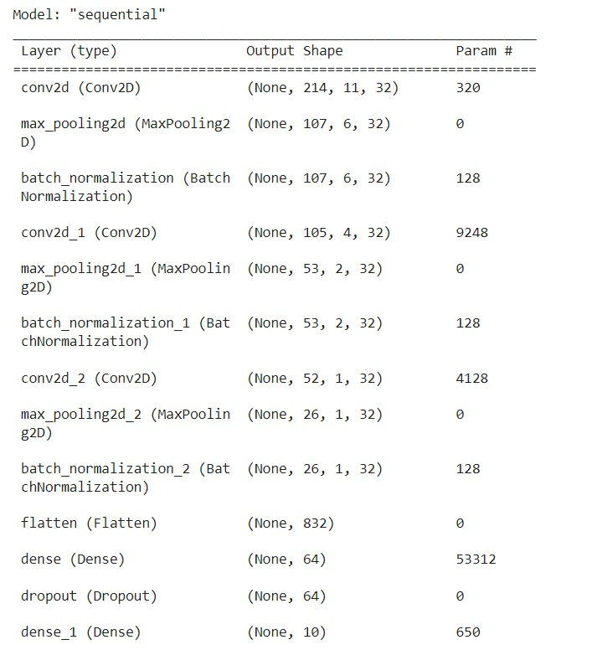
Model Architecture
Convolutional Layers: Extract features from audio data.
Pooling Layers: Reduce data complexity.
Activation Layers: Introduce non-linear relationships.
Flatten Layer: Prepare data for classification.
Dense Layers: Make final genre predictions.

Slide 8
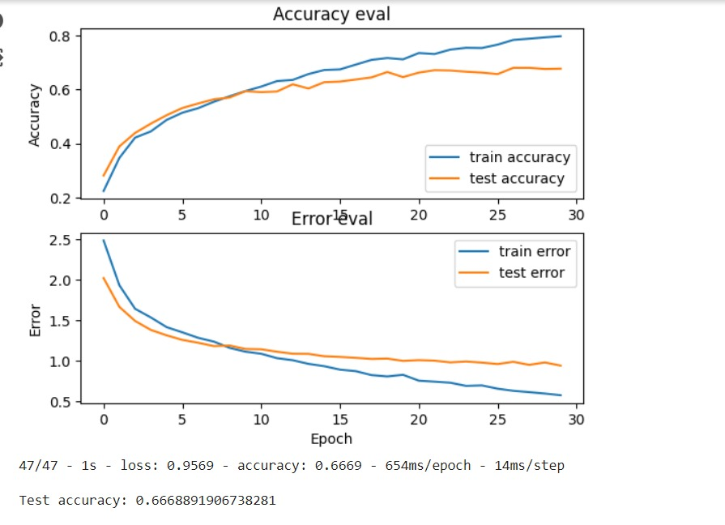
Model Accuracy

Slide 9
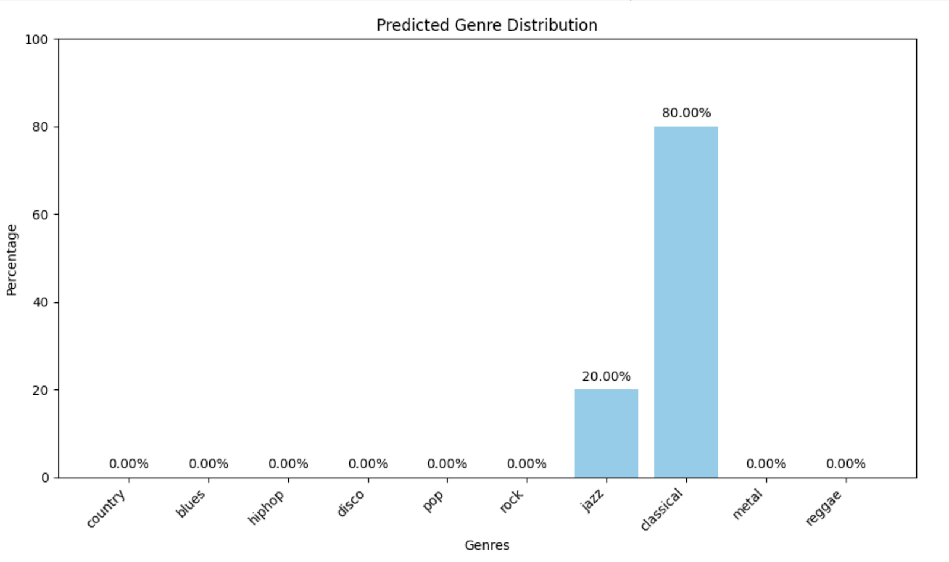
Results
In the plot, we see the distribution of predicted genres for the audio file. Each bar represents a genre, showing the percentage of segments predicted to belong to that genre. The genre with the highest percentage is labeled as the dominant genre. This visualisation helps understand the diverse musical elements in the file, aiding in genre analysis.

Slide 10
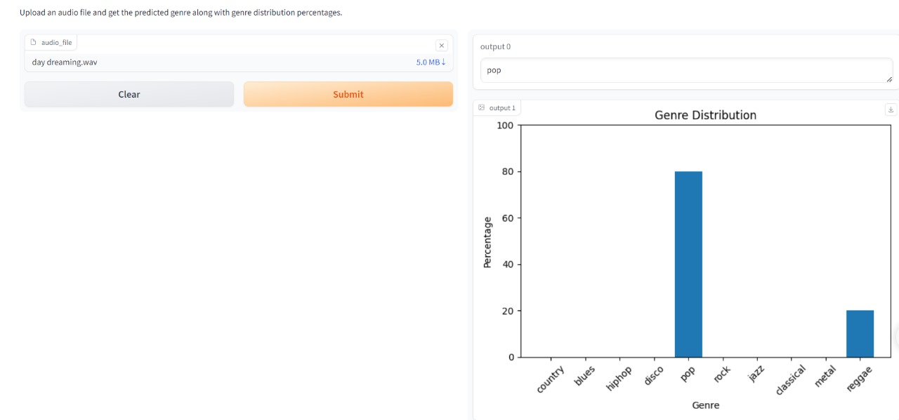
User Interface
The code creates an interface for predicting music genre from uploaded audio files. Users upload a file, and the system analyses its content using features like MFCCs. These features are then used by a pre-trained CNN model to predict the genre. The predicted genre, based on the most frequent occurrences across segments, is displayed as text output. This user-friendly interface is useful for organizing music collections or discovering new genres.

Slide 11
Conclusion
In summary, the project successfully built a music genre classifier using machine learning. It utilised MFCC features and a CNN model to predict genres with reasonable accuracy. The integration of Gradio provided a user-friendly interface for easy interaction. Overall, the project showcased the potential of ML in music analysis, with room for future enhancements in model refinement and UI improvements.

